Slide 1
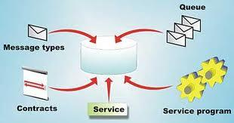
Service Broker

Slide 2
What is Service Broker?
New technology in SQL Server 2005
async messaging
Deferred processing
Queue Processing (unordered and FIFO)
nothing new to install or license, just enable it

Slide 3
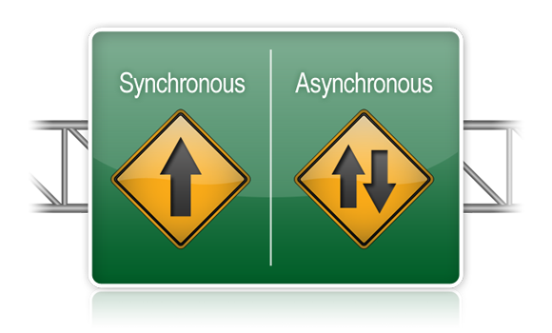
When should we consider using SB?
Long running processes...fire and forget!
loosely coupled, asynch processes that SCALE
fault tolerance
scale-out (distributed) possibilities
automatic eventing (a stored proc fires async when a message is enqueued)

Slide 4
When should we consider using SB?
respond to events without continuous polling (push queue)
Query Notifications (data caching) (pull queue)
data-intensive queuing operations
cheap, efficient transactions (no 2PC)
anytime we want to push our messaging support burden onto the DBAs

Slide 6
Isn't "database as a queue" an anti-pattern?
Usually yes
developers can't design and code queueing systems without having lock, block, and deadlock problems. SB solves this.
Think about PrcsStsCd and pull queues
...Too much polling
...SQL Server is efficient at CRUD or SELECTs, but rarely both
...not enough queue draining
...too tempting to put shared state in the db queue, causing tight coupling

Slide 7
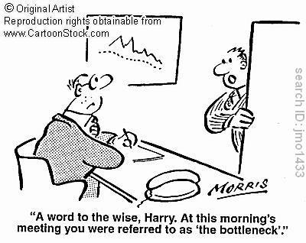
Isn't the db already the big bottleneck?
Yes, but this technology can alleviate our overburdened db servers by processing data smarter.

Slide 8
But we already have ESB/EMS!
Service Broker is complementary
It is not a JMS replacement
use it for all of the reasons mentioned already

Slide 9
Worklisting Tickling

